Slide 1


Slide 2

Navigating the NYC AirBnb Landscape
Insights for Hosts and Renters
Data Science Bootcamp - Spring 2024
Satyajit Sriram | Saurabh Parrikar | Bradley Guirand | Mofei Wang

Slide 3
Introduction
Table of Contents
The Dataset
Problem Statement
Overview
P1 - Data Preprocessing & Cleaning
P2 - Exploratory Data Analysis (EDA) & Visualization
P3 - Data Science Model
Conclusion

Slide 4
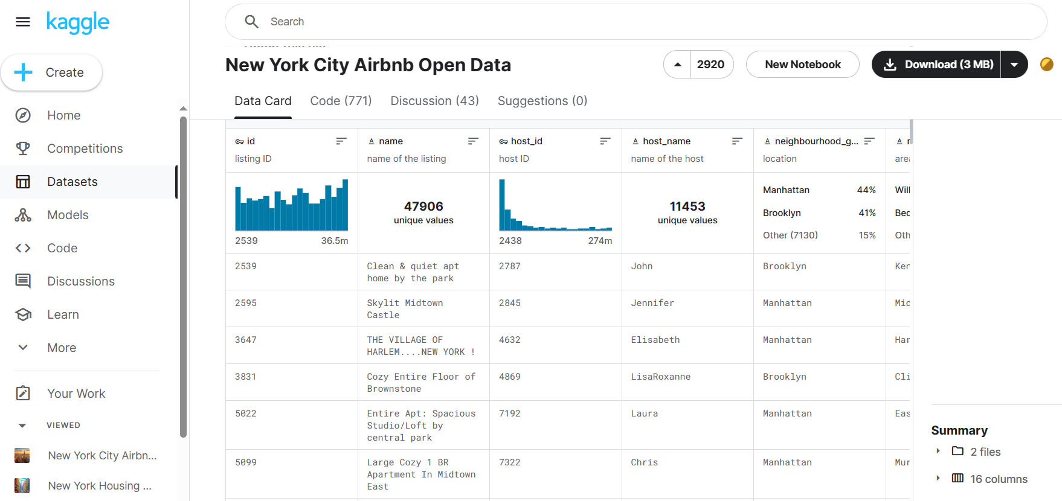
The Dataset
https://www.kaggle.com/datasets/dgomonov/new-york-city-airbnb-open-data/data
Since 2008, guests and hosts have used Airbnb to expand on traveling possibilities and present more unique, personalized way of experiencing the world. This dataset describes the listing activity and metrics in NYC, NY for 2019.
Fields to Analyze:
List_id
Listing_name
Host_id
Host_name
Neighborhood
Borough
Room_type
Lat-Long
Price
Reviews

Slide 5

Problem Statement
Predicting Rental Prices:
Develop a model to predict Airbnb rental prices in NYC based on features such as neighborhood, room type, minimum nights, and number of reviews.

Slide 6
Overview
In this report/presentation, we will delve into the world of Airbnb in NYC, focusing on the development of a model to predict rental prices based on these key features.
By analyzing the NYC Airbnb dataset and leveraging machine learning techniques, we aim to provide valuable insights into the factors influencing rental prices in one of the world's most vibrant cities.
With its diverse neighborhoods and array of listings, NYC has offered a dynamic Airbnb market where rental prices vary widely based on factors such as neighborhood, room type, minimum nights, and number of reviews.
Understanding and predicting these rental prices is essential for hosts looking to optimize their listings and for travelers seeking the best value for their stay.

Slide 7
Recap from Comments
Please provide any additional comments regarding this group's project design. | Please provide any additional comments about how the group addressed the stated problem in their project. | Please share any additional comments for the presentation and demo here. | Please provide any additional feedback or suggestions for this group regarding their project here.
- Need more detail on how they are going to solve the stated problem - Should reconsider why they are deleting missing values, there could be value there - Histogram is actually a bar chart - Use Log(price), Log(# of reviews) before visualizing and taking average | Good job here | - Shouldn't flip back and forth through the presentation - Introduce yourselves at the beginning then the problem - Add a section for "Next Steps" | N/A
Values above 10k and below 10 were thrown out but no methodological reason was given. Not clear overall what the project wants to accomplish, analytics-wise. | There was no clear problem statement or what the team is trying to work towards. | Should do a better job of keeping audience in mind and practice your flow of working through the slides and speaker parts. Lots of hesitating and flipping between slides. | NA

Slide 8
P1 - Data Preprocessing & Cleaning

Slide 9
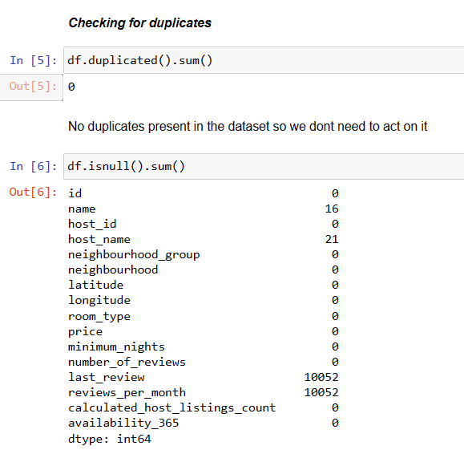
P1 - Data Preprocessing & Cleaning
Data preprocessing & Cleaning is crucial because it ensures that the dataset is accurate and ready for analysis.
This step helps to remove errors, inconsistencies, and irrelevant information, leading to more reliable and meaningful insights.

Slide 10
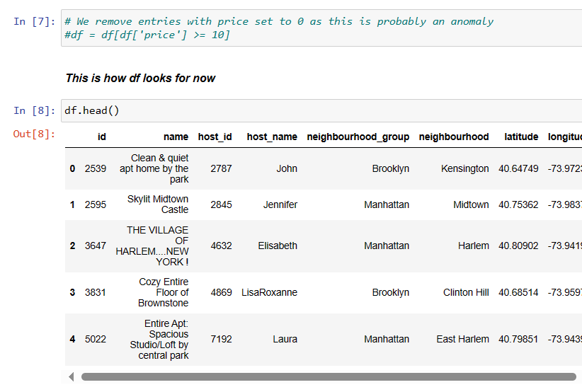
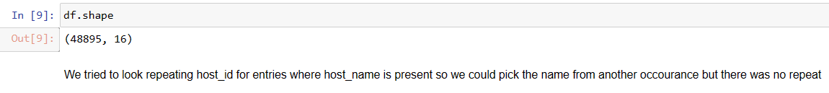
P1 - Data Preprocessing & Cleaning
After checking for duplicates & Null values, we move on to remove entries with price = 0 as this is probably an anomaly.

Slide 11
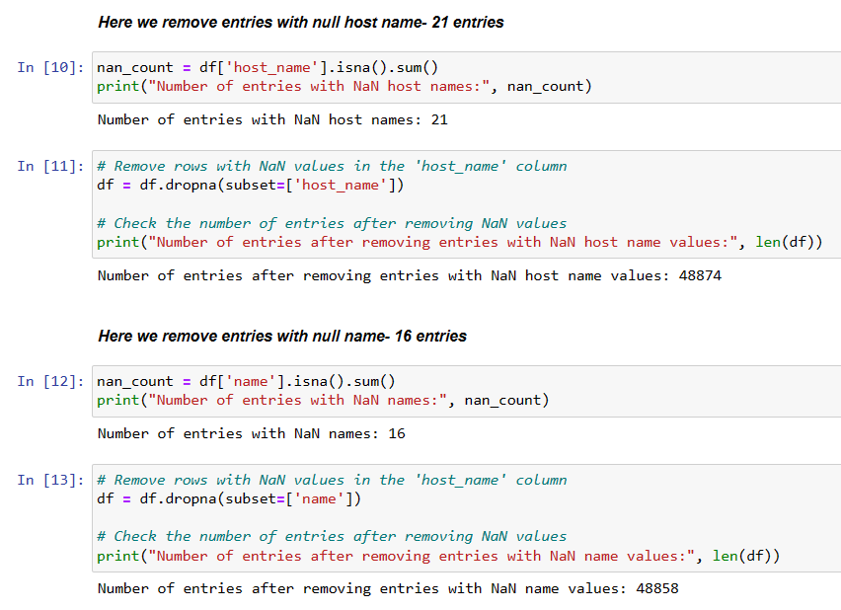
P1 - Data Preprocessing & Cleaning
Remove entries with Null host_name and name as these are 0.042% of the values.

Slide 12
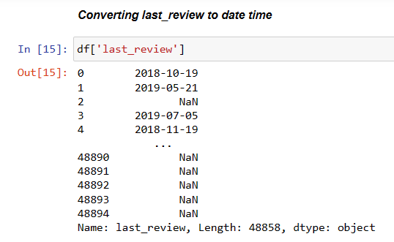
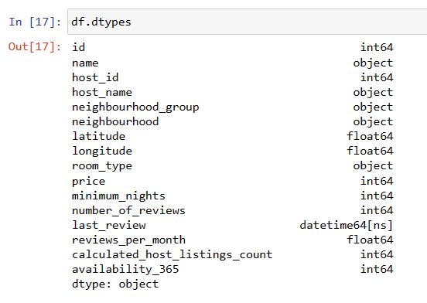
P1 - Data Preprocessing & Cleaning
Converting values from object to datetime.

Slide 13
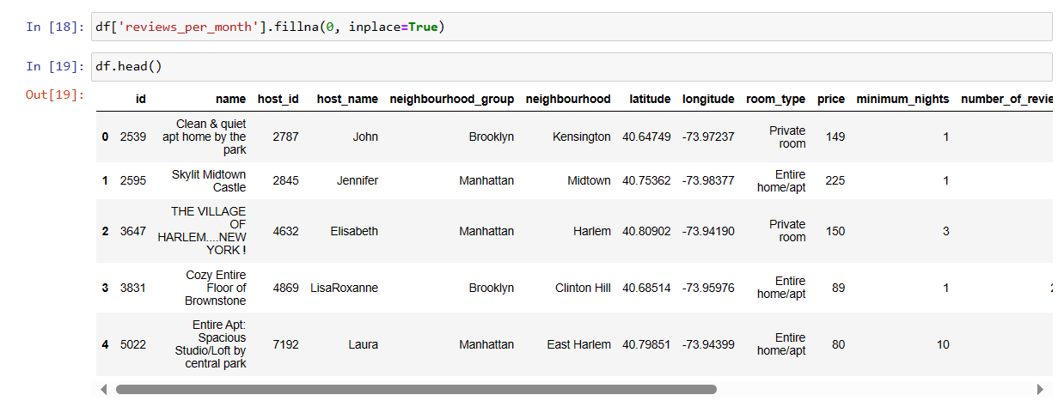
P1 - Data Preprocessing & Cleaning
We then convert all Null values in reviews_per_month into 0 using fillna() as this would actually indicate zero reviews for that property

Slide 14
P2 - EDA & Data Visualization

Slide 15
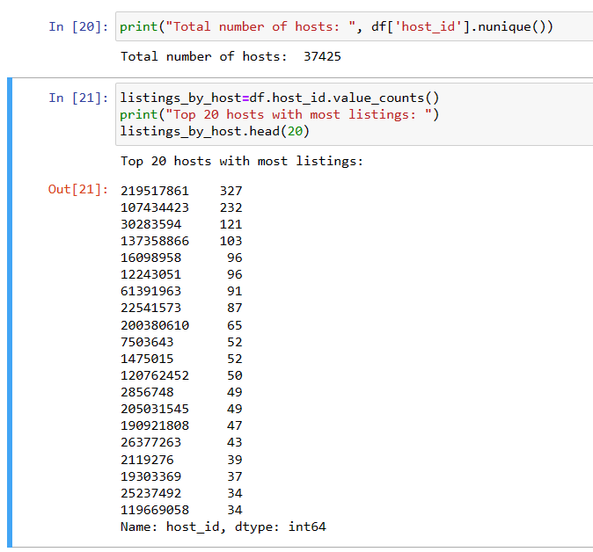
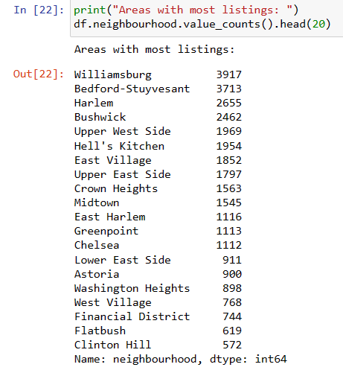
P2 - Exploratory Data Analysis & Visualization
Exploratory Data Analysis (EDA) and Visualization are essential as they help to uncover patterns, trends, and relationships in the data. This process provides valuable insights into the dataset, aiding in the selection of appropriate modeling techniques and variables for predictive modeling.

Slide 16
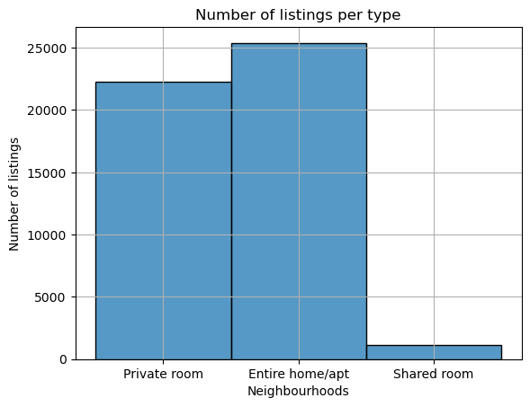
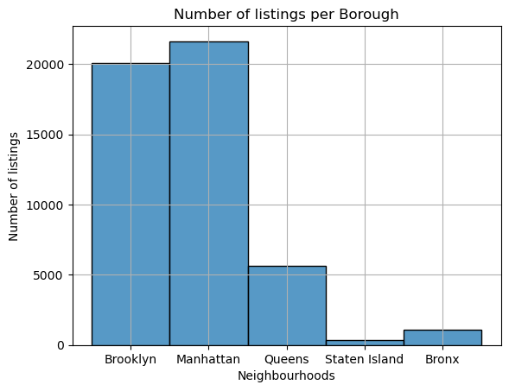
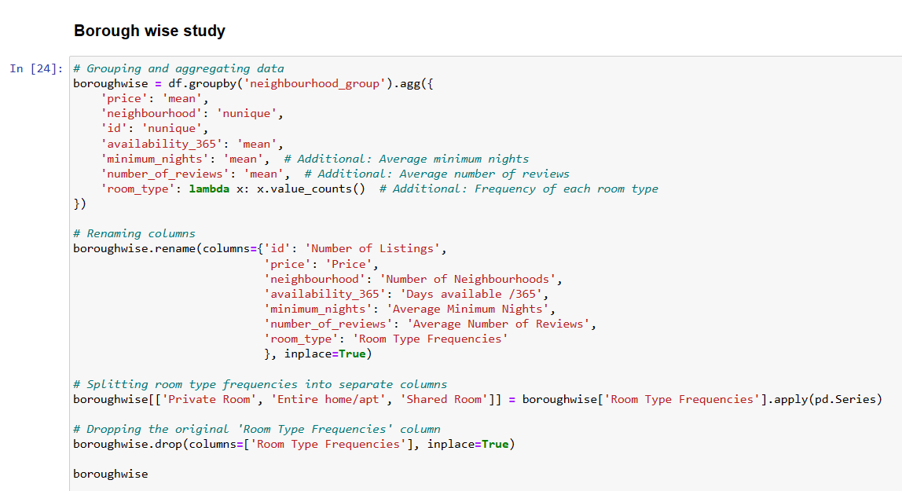
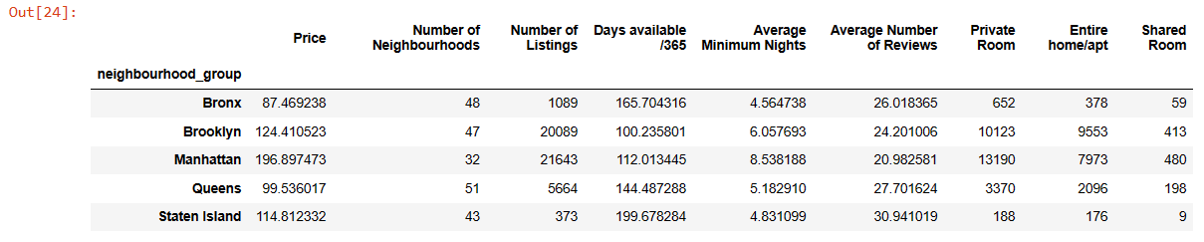
P2 - Exploratory Data Analysis & Visualization
Borough-wise Study

Slide 17
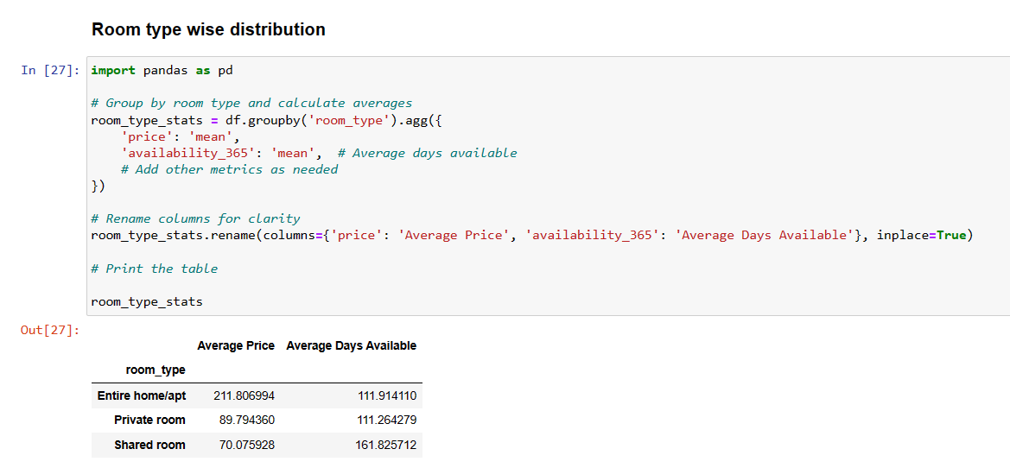
P2 - Exploratory Data Analysis & Visualization
Room Type-wise Study

Slide 18
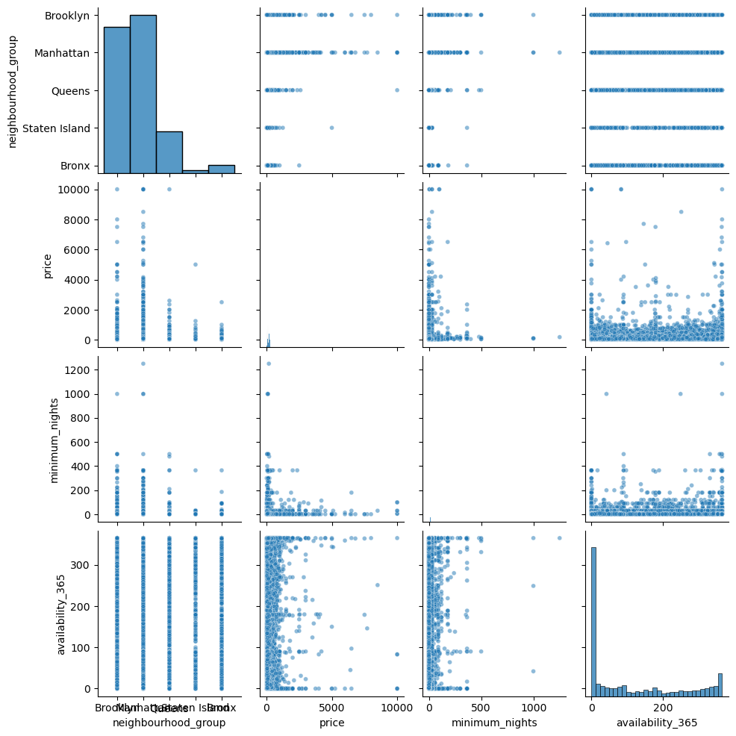
P2 - Exploratory Data Analysis & Visualization
Pairplot

Slide 19
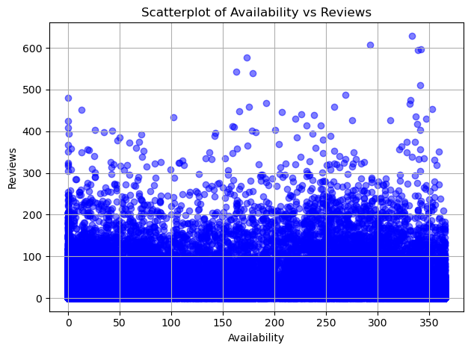
P2 - Exploratory Data Analysis & Visualization
There is not an obvious relationship between availability and reviews
As availability increases, the number of reviews does not change by a clear pattern

Slide 20
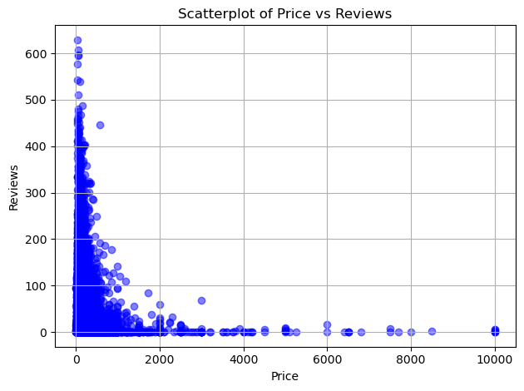
P2 - Exploratory Data Analysis & Visualization
There is an inverse correlation relationship between the price and number of reviews
The cheaper properties, also being more common, tend to have a higher amount of reviews

Slide 21
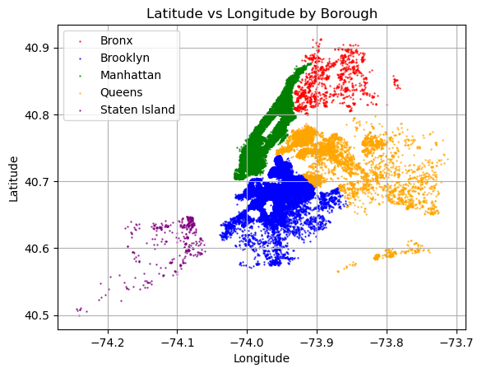
P2 - Exploratory Data Analysis & Visualization
Boroughs are separated by color and density is shown through the dots
Manhattan has the highest density, followed by Brooklyn
Staten Island has the lowest density

Slide 22
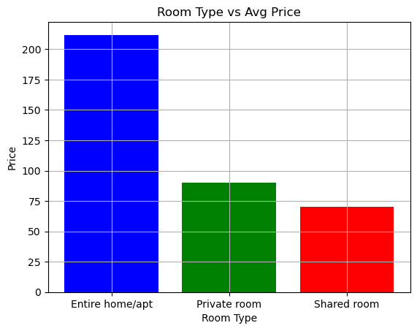
P2 - Exploratory Data Analysis & Visualization
Entire home/apt cost the most, on average ($220)
Private rooms come in second ($90)
Shared rooms are on average the cheapest room type ($70)

Slide 23
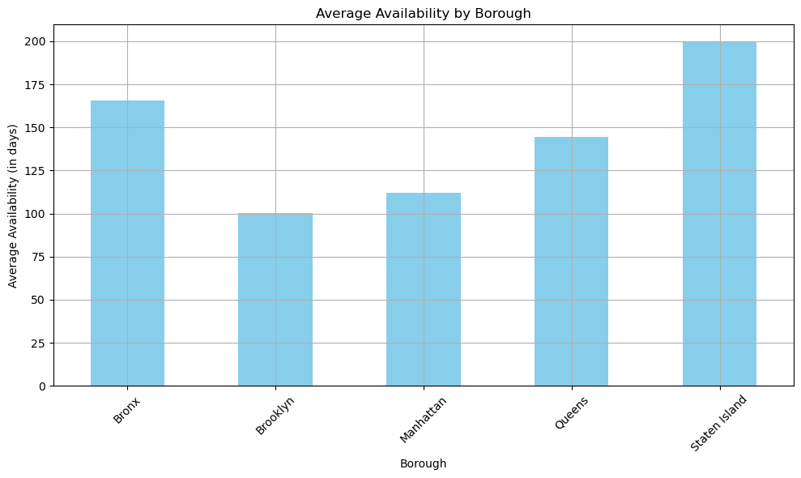
P2 - Exploratory Data Analysis & Visualization
Availability is highest in Staten Island and the Bronx, on average
Lowest in Brooklyn followed by Manhattan, on average

Slide 24
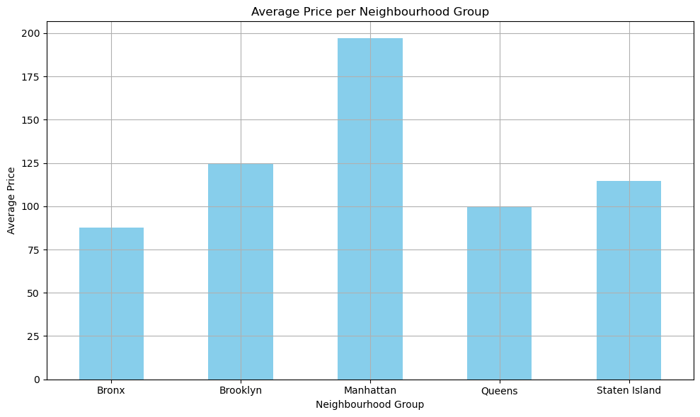
P2 - Exploratory Data Analysis & Visualization
Manhattan has the highest average price ($195)
The Bronx has the lowest average price ($85)

Slide 25
P3 - The Price Prediction Model

Slide 26
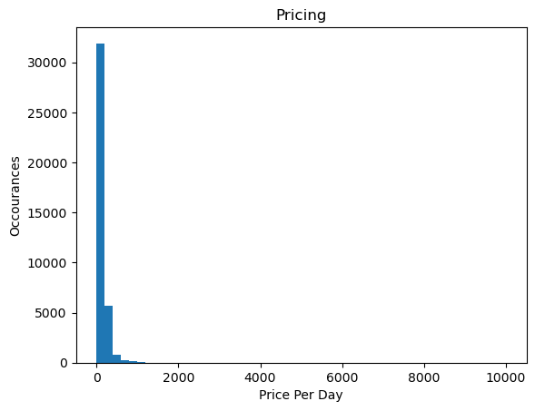
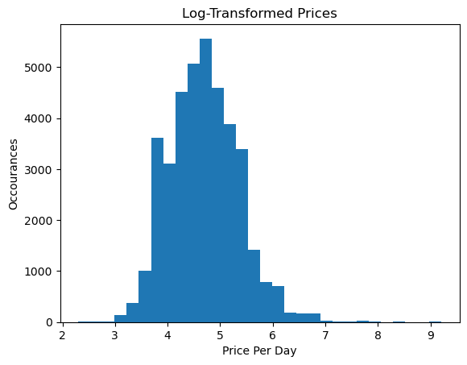
P3 - The Model (Price Prediction)
Step 1- Taking log value of price

Slide 27
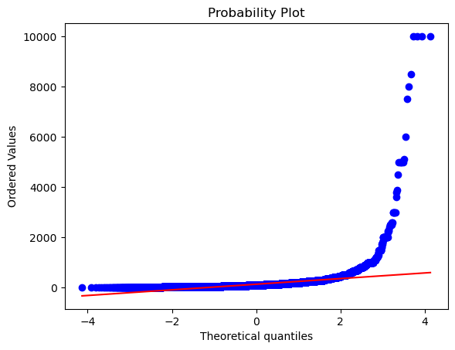
P3 - The Model (Price Prediction)
Step 2- Probability plot analysis
Close Fit at Lower Tail: The closeness of the blue dots to the red line at the lower tail suggests that the lower values closely follow a normal distribution.
Deviation in Upper Tail: As the values increase, the blue dots start to deviate significantly from the red line, particularly at the upper tail (right side). This indicates a heavy right skew, meaning there are more high values than what a normal distribution would predict.

Slide 28
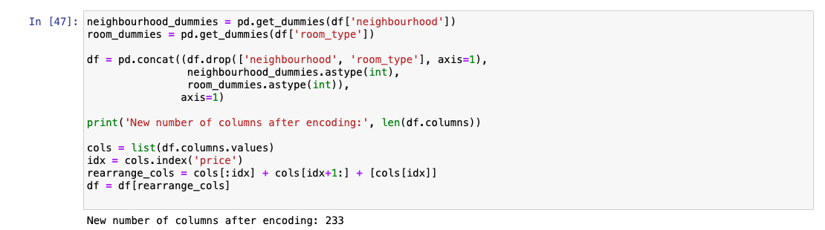
P3 - The Model (Price Prediction)
Step 3- Encoding
Encode categorical data
Have hot encoded columns
Adjust for Target variable (Price)

Slide 29
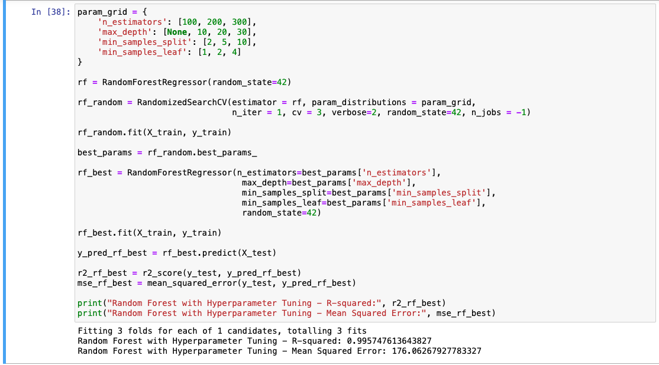
P3 - The Model (Price Prediction)
Step 4 - Hyperparameter tuning and Random Forest Results & Outcomes
R squared value of close to 99%
Mean Squared Error (MSE) of
around 175

Slide 30
Conclusions from the Model
Benefits & Possible scope of improvement in the future
Very accurate in given data
Can help new owners/ people new to Airbnb and suggest a price for their listing- not too high or low
Data could include features about the listing to help better predict price over larger geographical areas
We could have more temporal data to judge the traffic of airbnbs over time.
Moving forward, this predictive model can be a valuable tool for hosts to set competitive prices and maximize their earnings, while also helping travelers find affordable and suitable accommodations in the vibrant city of NYC.
As the Airbnb market continues to evolve, understanding these pricing dynamics will be essential for both hosts and travelers to make informed decisions.

Slide 31
Thank You

